Slide 1

CloudVault Eclipse
Secure Cloud Document Management on AWS
A full-stack, cloud-native platform for secure document storage, role-based access control, and seamless collaboration — built with Python Flask, AWS S3, and Docker.
Notes:
• Welcome everyone to CloudVault Eclipse — our secure cloud document management solution • This is a full-stack, cloud-native platform built on AWS infrastructure • Key capabilities: secure document storage, role-based access control, and real-time collaboration • Built with modern tech stack: Python Flask for the backend, AWS S3 for scalable storage, and Docker for containerization • Think of this as an enterprise-grade alternative to traditional file sharing — with security and access controls built in from the ground up • We'll walk through the architecture, features, and how it all comes together

Slide 2
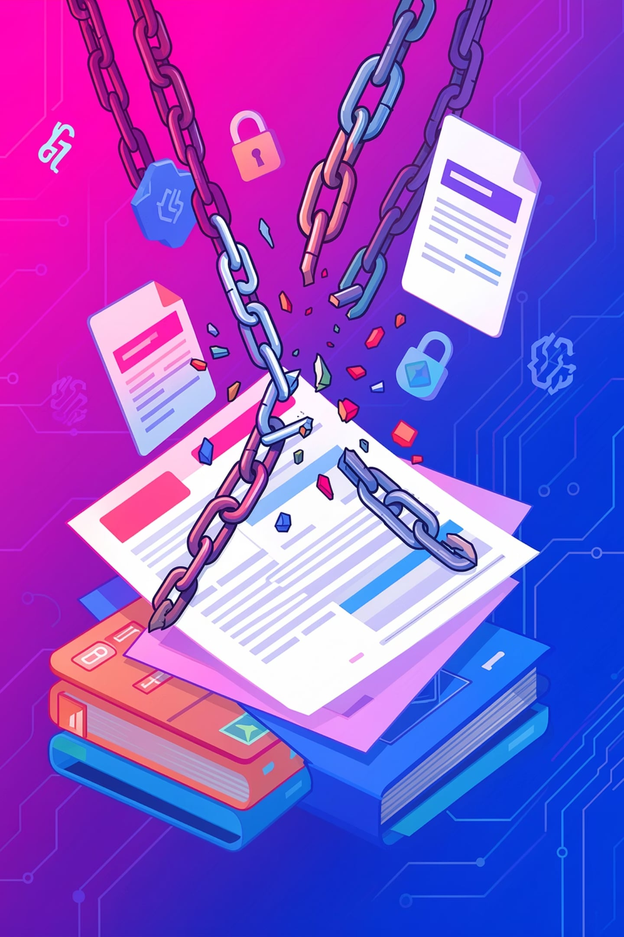

Why Traditional Document Management Falls Short
Outdated systems create friction, risk, and costly overhead for modern enterprises.
Outdated systems create friction, risk, and costly overhead for modern enterprises.
Fragmented Access & Collaboration
Siloed files slow sharing and make teamwork harder.
Vulnerable Security & Compliance
Limited controls leave sensitive data exposed.
Scalability & Maintenance Burden
Growth drives upgrades, downtime, and IT overhead.

Slide 3
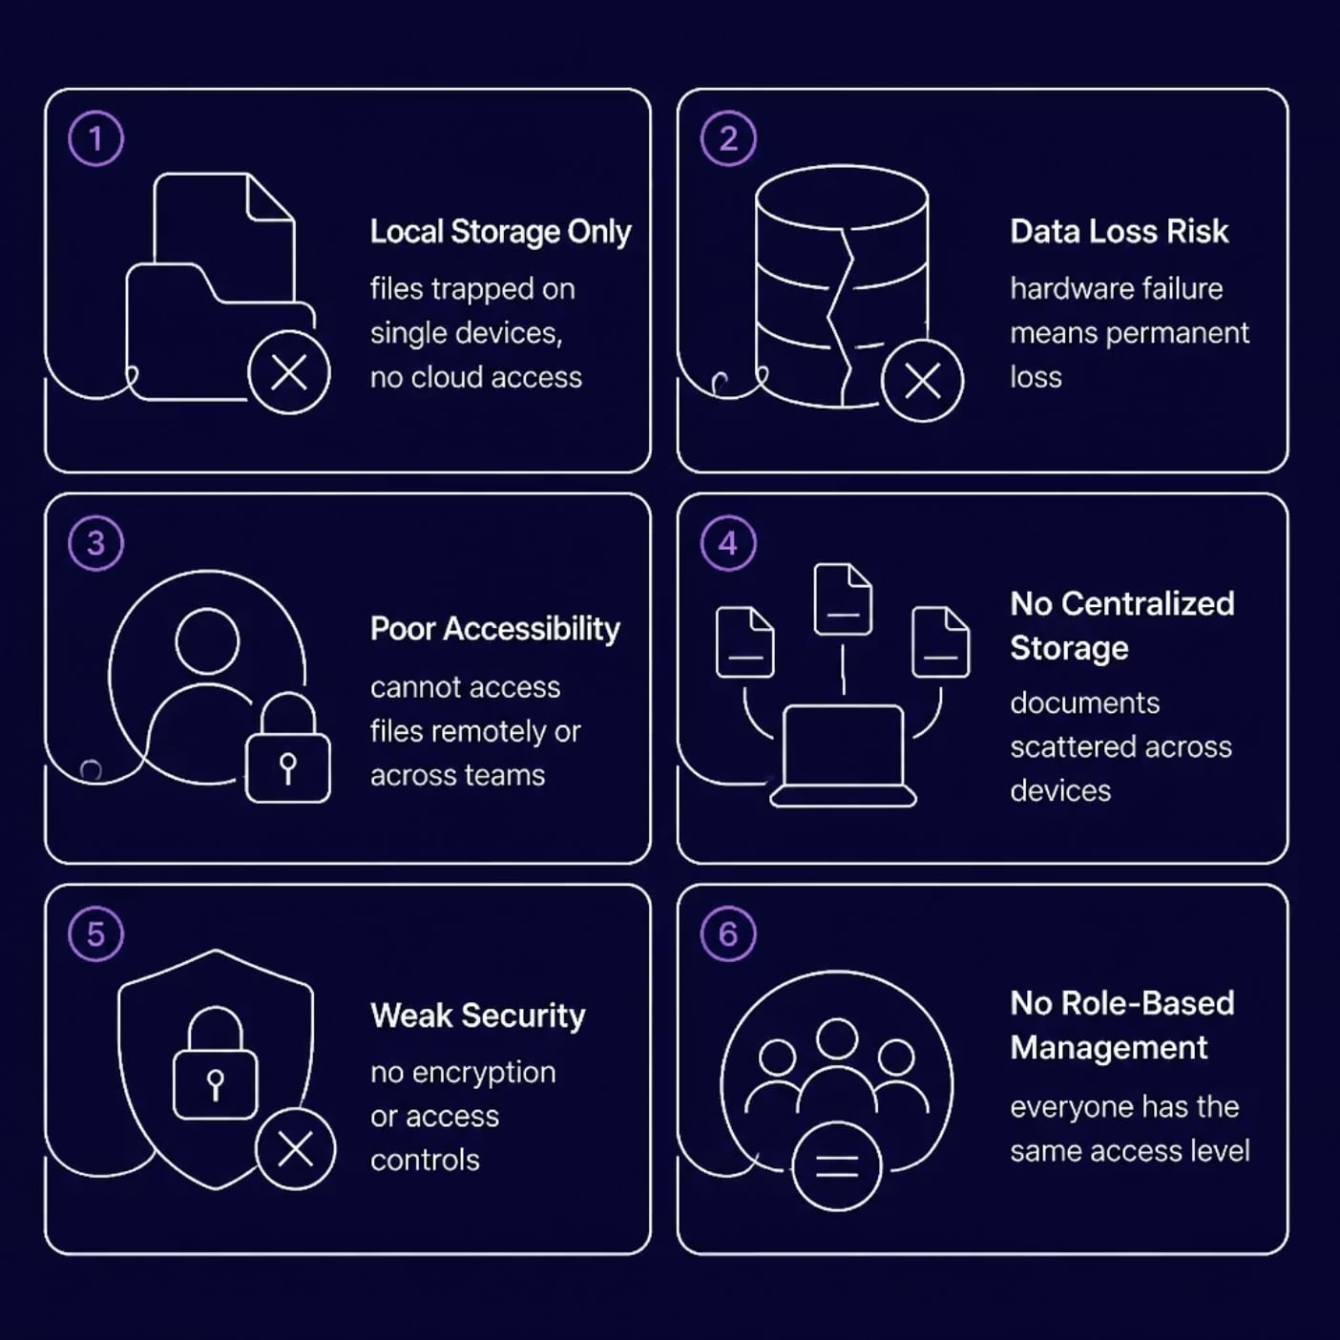
THE CHALLENGE
Why Traditional Document Management Falls Short
Organizations relying on local file storage face critical vulnerabilities — from data loss and limited access to weak security and no centralized control. CloudVault Eclipse was designed to solve these problems.
Notes:
• Start by emphasizing the pain point — traditional document management systems are holding organizations back • Local storage creates a false sense of security but actually introduces major risks: Files stuck on single devices with no cloud backup One hardware failure = permanent data loss Teams can't access documents remotely or collaborate effectively • Scattered documents across multiple devices means no centralized control or visibility • Security is a major gap — no encryption, no access controls, everyone has the same permissions regardless of role • These limitations force organizations to work inefficiently and expose them to unnecessary risk • This is exactly what CloudVault Eclipse was built to address — we solve all six of these critical problems with one integrated solution

Slide 4
WHAT WE SET OUT TO BUILD
Project Objectives
Secure Document Storage
Email OTP Verification
Docker Deployment
Two-factor authentication for secure user onboarding
Containerized, portable, and consistent across environments
Encrypted, access-controlled file storage on AWS S3
Cloud-Based Access
Role-Based Access Control
Access documents anytime, anywhere via the web
Admin and user roles with distinct permissions
Notes:
• We set out to build a secure document management system with five core objectives • Secure Document Storage — All files are encrypted and stored on AWS S3 with strict access controls to protect sensitive data • Cloud-Based Access — Users can retrieve their documents from anywhere, anytime through a web interface for maximum convenience • Email OTP Verification — We implemented two-factor authentication using one-time passwords sent via email to ensure only authorized users can access the system • Role-Based Access Control — The system distinguishes between admin and user roles, each with their own set of permissions and capabilities • Docker Deployment — We containerized the entire application so it runs consistently across different environments and is easy to deploy and scale

Slide 5
UNDER THE HOOD
Technology Stack
Frontend
Backend
Database
HTML5, CSS3 & JavaScript — responsive, modern UI
Python Flask — lightweight, flexible web framework
SQLite — stores users, roles, and document metadata
Cloud Storage
Deployment
Authentication
Amazon S3 — scalable, durable object storage
Docker — containerized, portable application environment
Email OTP — secure two-factor user verification
Security
Password Hashing - Passwords are securely encrypted before storage to protect user credentials from unauthorized access.
Role Based Access Control - Access permissions are assigned based on user roles, ensuring administrators and users have appropriate privileges.
Notes:
• Frontend — Built with HTML5, CSS3, and JavaScript for a responsive, modern user interface that works across devices • Backend — Python Flask provides a lightweight and flexible framework for handling business logic and API requests • Database — SQLite stores all user accounts, roles, and document metadata efficiently • Cloud Storage — Amazon S3 gives us scalable, reliable object storage for documents with built-in redundancy • Deployment — Docker containerization ensures the application runs consistently across different environments • Authentication — Email OTP provides secure two-factor verification to protect user accounts • Security — We use password hashing to encrypt credentials before storage, and role-based access control to ensure users only access what they're authorized to see

Slide 6
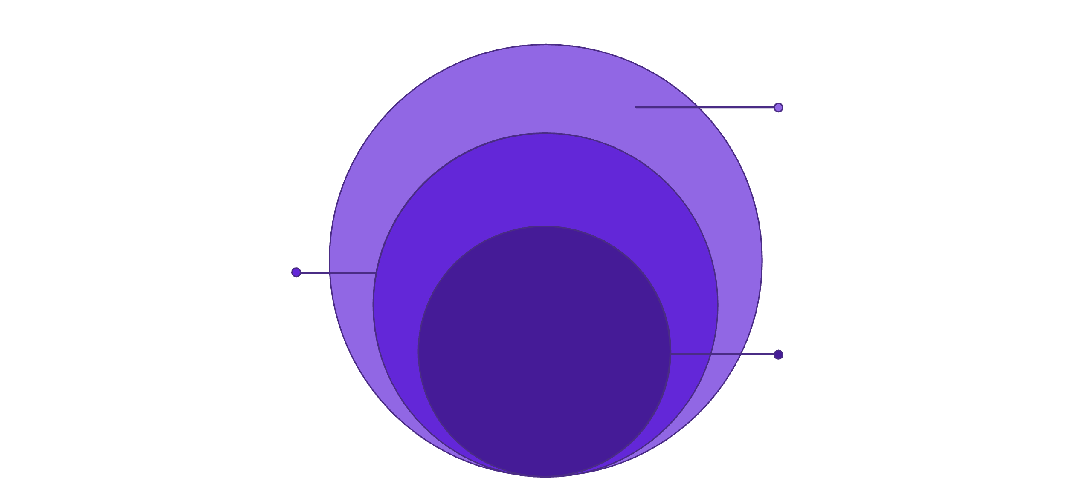
HOW IT ALL CONNECTS
System Architecture
Data & Deployment
SQLite, S3 storage, Docker deployment
Flask Backend
API and business logic
User Interface
Web browser client
CloudVault Eclipse uses a clean three-tier architecture. The Flask backend acts as the central orchestrator — handling authentication, processing requests, managing document metadata in SQLite, and interfacing with AWS S3 for durable file storage. Docker ensures the entire stack runs consistently across any environment.
Notes:
• Three-tier architecture keeps everything organized and scalable • Outermost layer — User Interface: Web browser client where users interact with the system • Middle layer — Flask Backend: The brain of the operation Handles user authentication and security Processes all incoming requests Manages document metadata in SQLite Communicates with AWS S3 for file storage • Inner layer — Data & Deployment: The foundation SQLite database for structured data S3 storage for reliable, durable file handling Docker containerization ensures consistent deployment anywhere • This clean separation means each component has a specific job, making the system easier to maintain, scale, and debug

Slide 7
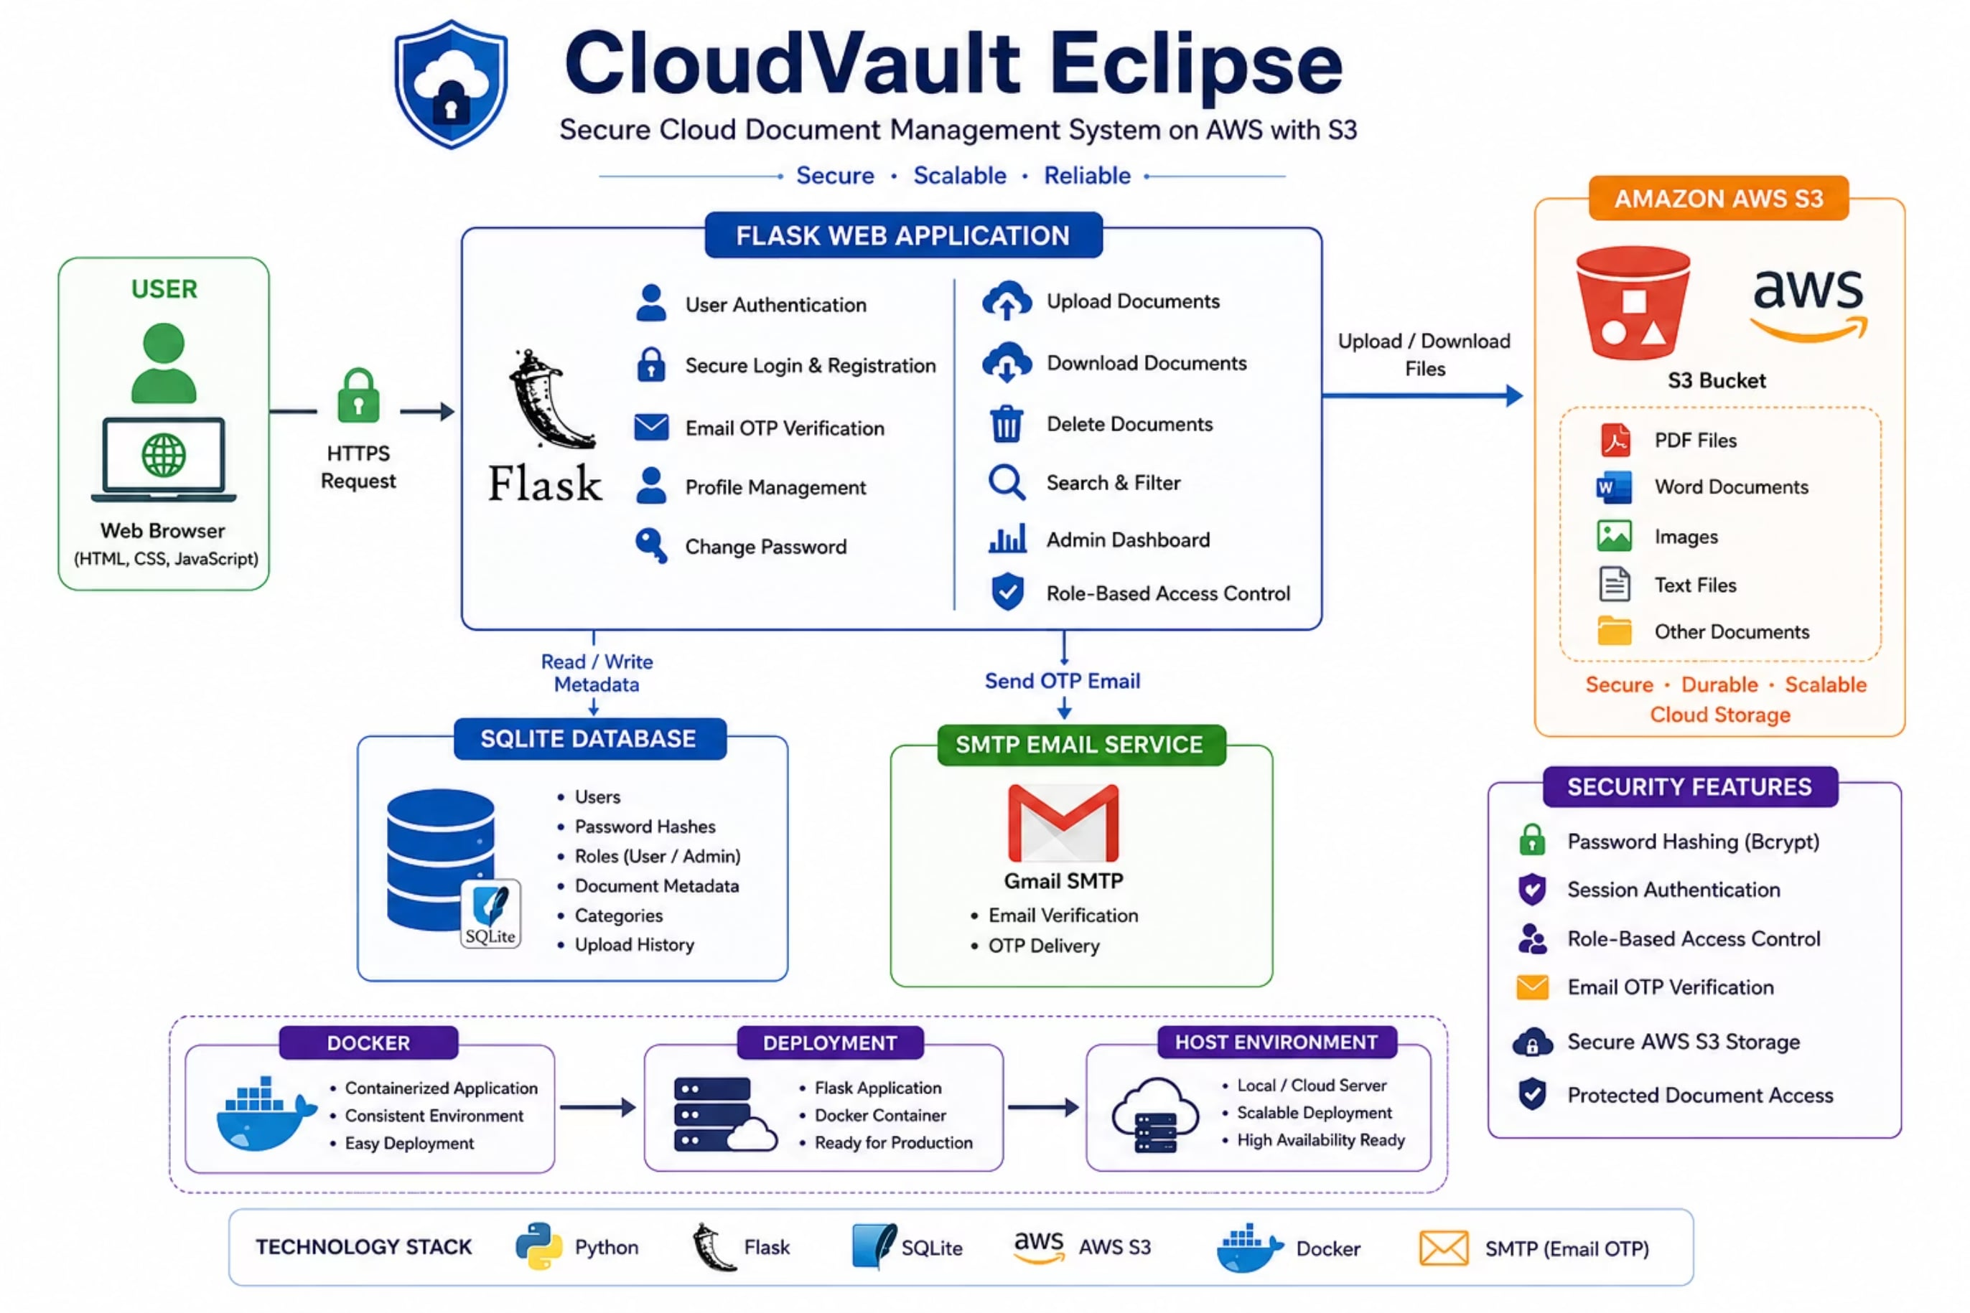
Notes:
• Walk through the architecture diagram from left to right • Point out the key components and how they interact with each other • Highlight the data flow and connections between layers • Emphasize how this design supports scalability and modularity • Note any critical dependencies or integration points • Connect back to how this architecture enables the features/benefits discussed earlier

Slide 8
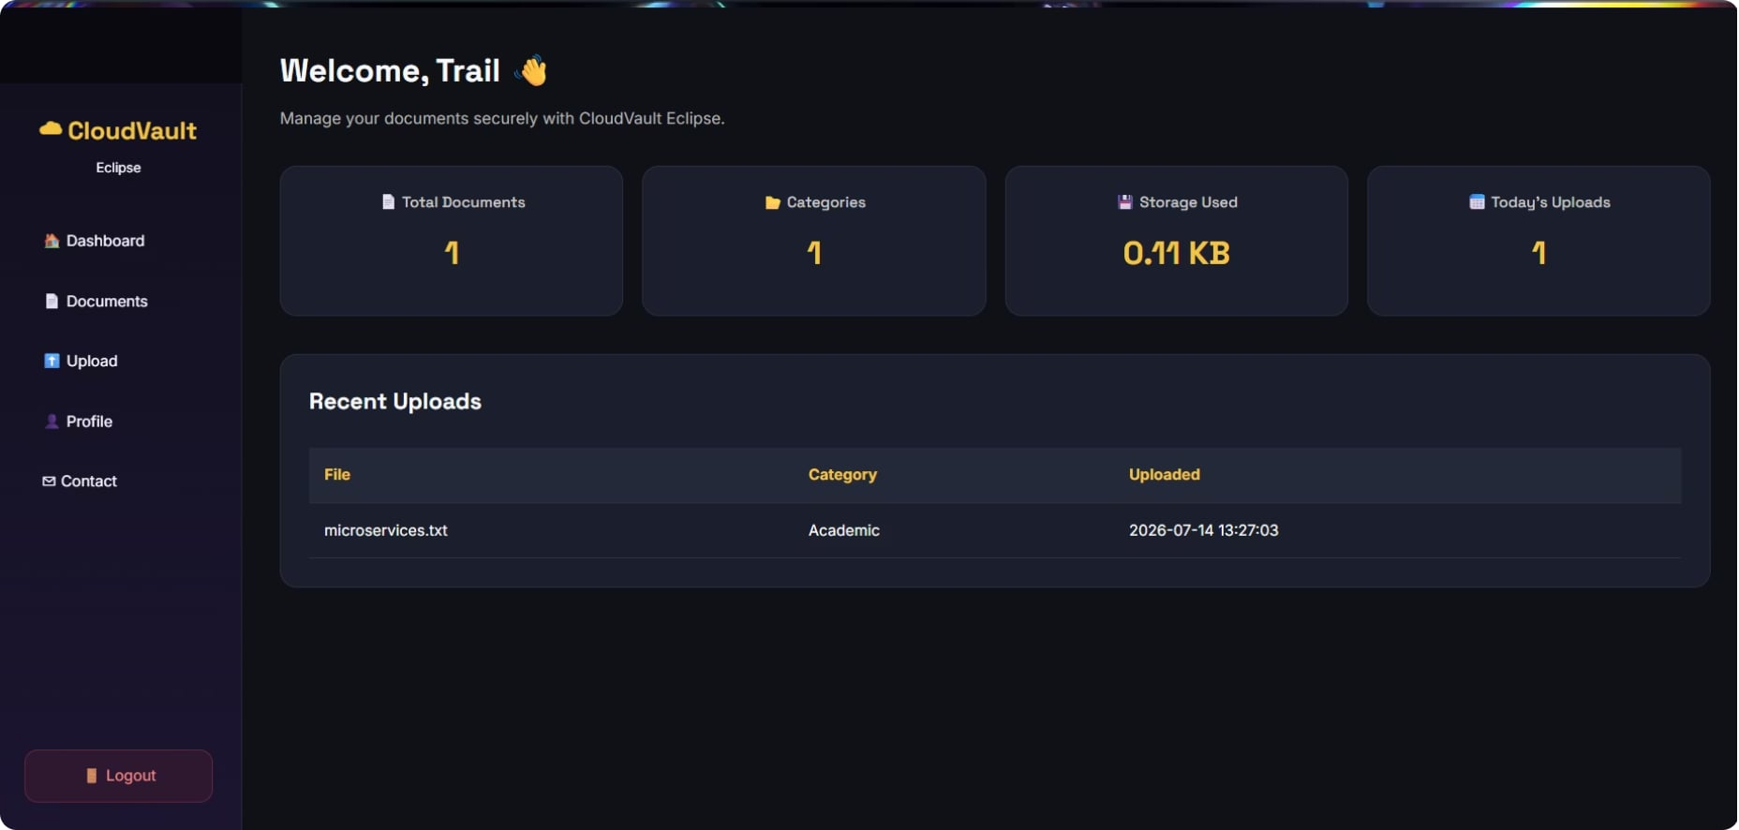
END-USER EXPERIENCE
User Module
🔐 Authentication Flow
Registration → Login → Email OTP Verification → Secure Session
📁 Document Operations
Upload, search, download, and delete documents from a personalized dashboard
⚙️ Profile Management
Update profile details and change password securely
Notes:
• This is the User Module – the core end-user experience of our platform • On the left you'll see the user dashboard interface – a clean, intuitive workspace where users manage their activity • Let me walk you through the three key features: Authentication Flow – We've implemented a secure multi-step process: users register, log in, verify their email with an OTP, and then get a secure session. This ensures we're protecting user accounts from the start. Document Operations – Users have full control over their documents. They can upload new files, search through existing ones, download what they need, and delete documents they no longer want. Everything happens from their personalized dashboard. Profile Management – Users can keep their information current by updating profile details whenever needed, and they can change their password securely if required. The whole experience is designed to be straightforward and secure – users get what they need without unnecessary complexity.

Slide 9
ADMINISTRATIVE CONTROL
Admin Module
Admin Login
Dedicated, secure authentication for administrators
User Management
Promote or delete user accounts with full control
Storage Monitoring
Track AWS S3 usage and document storage metrics
Notes:
• This is the Admin Module – the administrative control center of our system • Three key capabilities: Admin Login: Administrators have a dedicated, secure authentication system separate from regular users. This ensures only authorized personnel can access admin functions. User Management: Admins have full control to promote users to higher roles or delete accounts as needed. This gives you complete flexibility in managing your user base. Storage Monitoring: Track your AWS S3 usage and document storage metrics in real-time. This helps you stay on top of your infrastructure costs and capacity.

Slide 10
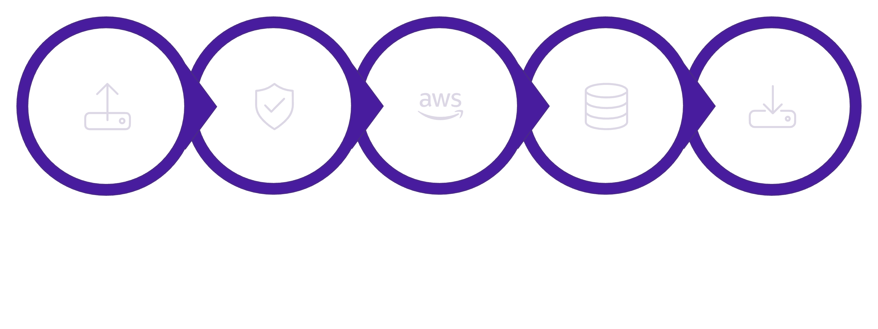
CLOUD INFRASTRUCTURE
AWS S3 Integration
Authenticate
Save Metadata
Upload
Store
Download
Every uploaded document is securely transferred to an Amazon S3 bucket. Flask manages authentication and authorization before any file operation. Document metadata — including owner, name, and timestamp — is stored in SQLite, enabling fast search and access control without querying S3 directly.
Notes:
• Walk through the five-step process: Upload → Authenticate → Store → Save Metadata → Download • Emphasize security: all documents are securely transferred to Amazon S3 • Explain Flask's role: handles authentication and authorization before any file operation occurs • Highlight the metadata strategy: document owner, name, and timestamp stored in SQLite • Note the efficiency benefit: metadata in SQLite allows fast search and access control without needing to query S3 directly — keeps operations lean and responsive • This architecture separates concerns: S3 handles file storage, SQLite handles quick lookups and permissions

Slide 11
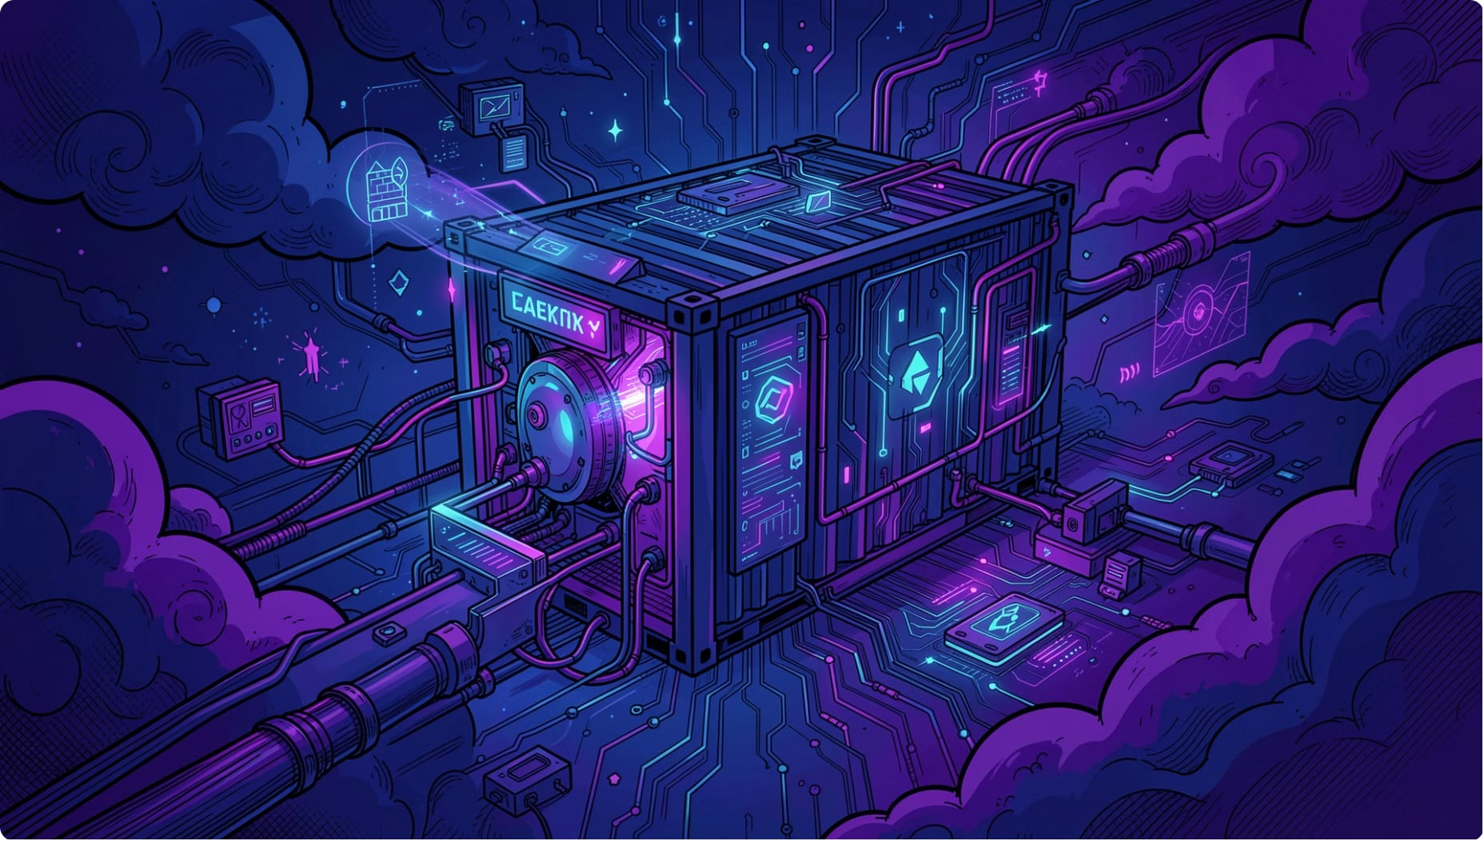
DEPLOYMENT STRATEGY
Docker Deployment
CloudVault Eclipse is fully containerized using Docker, packaging the Flask application, dependencies, and configuration into a single portable image — ensuring consistent behavior across development, testing, and production.
Easy Deployment
Portability
Consistency
One command to spin up the full stack
Runs identically on any Docker-enabled host
Eliminates environment-specific bugs
Notes:
• CloudVault Eclipse is fully containerized with Docker — everything the app needs is packaged into one portable image • This ensures the application behaves exactly the same whether it's running on your laptop, a test server, or production Key benefits: • Easy Deployment — Just one command to get the entire stack up and running • Portability — The container works identically on any machine that has Docker installed, no matter the underlying OS or configuration • Consistency — Eliminates those frustrating "it works on my machine" problems by removing environment-specific variables

Slide 12
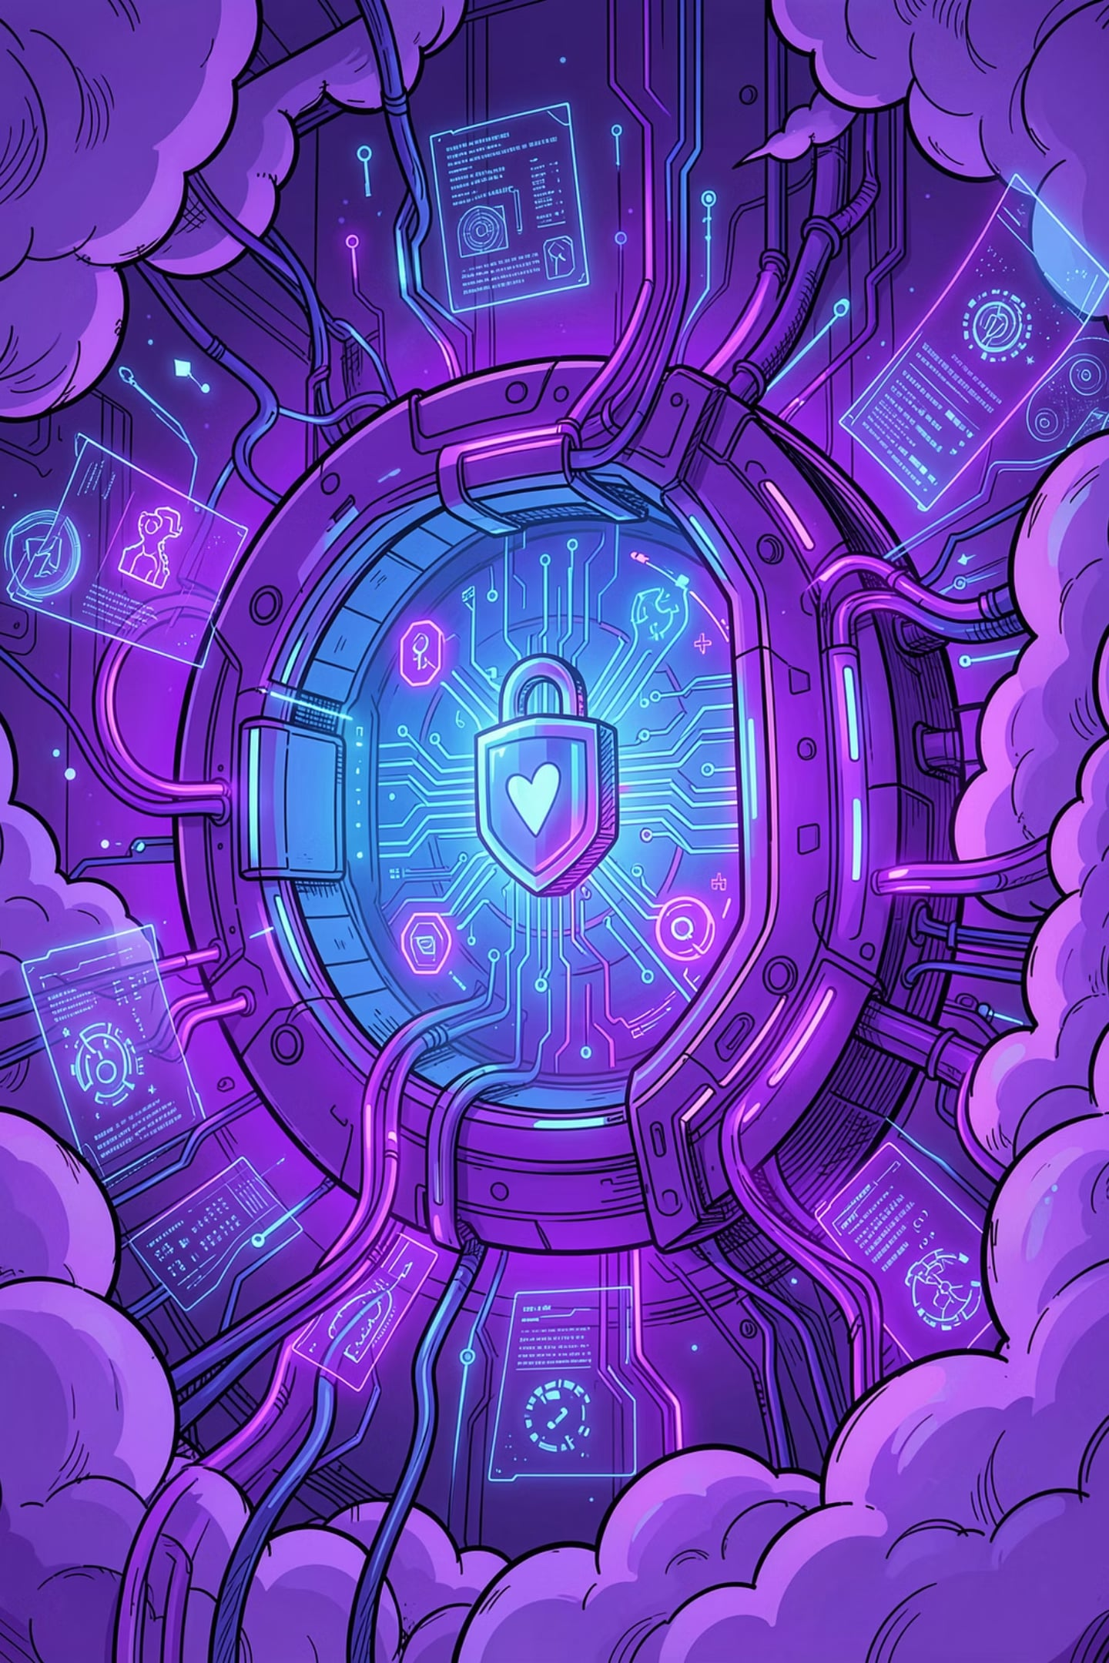

SUMMARY
Key Takeaways
🔒 Security First
OTP verification, role-based access, and encrypted cloud storage
☁️ Cloud-Native
Built on AWS S3 for scalable, durable document storage
🐳 Containerized
Docker deployment ensures portability and consistency
👥 Role-Based
Distinct Admin and User modules with granular permissions
CloudVault Eclipse demonstrates practical application of cloud security, full-stack development, and DevOps principles — core competencies of the .
Notes:
• Security First — We've implemented multiple layers of protection: OTP verification for authentication, role-based access control to limit what users can do, and encrypted storage in the cloud. This ensures your data is protected at every step. • Cloud-Native Architecture — We built this on AWS S3, which gives us scalability and durability. Your documents are stored reliably and can grow with demand without infrastructure headaches. • Containerized Deployment — Using Docker means the application runs the same way everywhere—your laptop, a test server, or production. No more "it works on my machine" problems. • Role-Based Access — We've separated Admin and User functionality with granular permissions. Admins manage the system, users access their documents. Everyone gets exactly what they need, nothing more. • Bottom line — CloudVault Eclipse brings together cloud security best practices, modern full-stack development, and DevOps principles in one working application.

Slide 13
THE ROAD AHEAD
Future Enhancements
CloudVault Eclipse is built for scalability and growth. We envision several key enhancements to further empower secure collaboration and efficiency.
Enhanced Search & OCR
Advanced Collaboration
Implement full-text search capabilities and Optical Character Recognition (OCR) for scanned documents, making all content easily discoverable.
Introduce real-time co-editing, version history, and secure sharing options for external stakeholders.
Audit Trails & Reporting
Mobile Access
Develop comprehensive logging of all document activities for compliance, security audits, and administrative oversight.
Create dedicated mobile applications for iOS and Android, ensuring secure document access on the go.
Notes:
• CloudVault Eclipse is designed to grow with your needs—we have an exciting roadmap ahead • Enhanced Search & OCR: We're adding full-text search so you can find anything instantly, plus OCR technology to make scanned documents searchable and accessible • Advanced Collaboration: Teams will be able to edit documents together in real-time, track version history, and securely share with external partners without compromising security • Audit Trails & Reporting: Complete logging of all document activities—essential for compliance, security audits, and giving administrators full visibility into what's happening in the system • Mobile Access: Dedicated iOS and Android apps coming soon so your team can securely access documents anytime, anywhere • These enhancements reflect our commitment to making CloudVault Eclipse the most secure and efficient collaboration platform available

Slide 14

Empowering Secure Collaboration
CloudVault Eclipse delivers on the promise of modern, secure, and accessible document management. Let's discuss how this solution can transform your data strategy.
Thank you : By - Divya H Kishore
Notes:
• This is your closing statement—bring energy and confidence • Emphasize that CloudVault Eclipse isn't just a tool, it's a transformative solution • Hit the three key pillars: modern, secure, and accessible • Transition to discussion/Q&A—invite audience to share their thoughts on how this could work for their organization • Reinforce that you're ready to explore how this addresses their specific data management challenges

